Slide 1



RESUME SCREENIG SYSTEM
Extract skills and experience from resumes using NLP
BY: Batch 15
AMRUTHA VARSHINI (Y23CD175)
N.SAI KALPANA (L24CD208)
V.SAHITHYA (Y23CD195)

Slide 2

INTRODUCTION TO NLP:
Natural Language Processing (NLP) is a field of Artificial Intelligence that enables computers to understand and process human language.
NLP is commonly used to:
Analyze text data
Extract key information
Automate document processing
In this project, NLP is used to analyze resumes and automatically screen candidates based on job requirements.

Slide 3

PROBLEM STATEMENT
Organizations receive a large number of resumes for each job opening.
Problems with manual resume screening:
Time consuming process
High chances of human bias
Difficult to analyze large volumes of resumes
Risk of missing suitable candidates
Hence, an automated resume screening system using NLP is required.

Slide 4
OBJECTIVES OF THE PROJECT
To collect resumes from candidates
To extract important information from resumes
To apply NLP techniques on resume text
To match resumes with job requirements
To rank or shortlist suitable candidates automatically

Slide 5
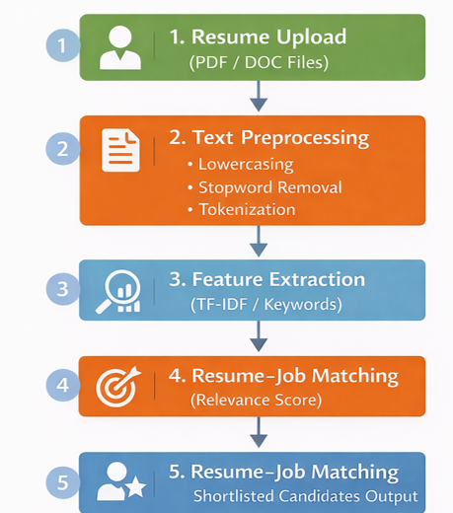

SYSTEM ARCHITECTURE:

Slide 6

PROCESS:
.
Resume Upload: Candidates upload their resumes in PDF or DOC format into the system.
Text Preprocessing: The resume text is cleaned by converting to lowercase, removing stop words, and tokenizing the text.
Feature Extraction: Important skills and keywords are extracted using the TF-IDF technique to convert text into numerical form.
Resume–Job Matching: The resume content is compared with the job description to calculate a relevance score.
Automated Sorting: The system automatically categorizes resumes into
"Shortlisted" or "Rejected" folders based on a set threshold.

Slide 7

Tools & Technologies used (The "Software")
Python: The core programming language used to build the entire system logic.
Scikit-learn: The primary machine learning library used for TF-IDF Vectorization and Cosine Similarity calculations.
PDFMiner: The specialized tool used to extract raw text data from PDF resumes.
Regex: Used for Text Preprocessing and cleaning, such as removing noise and symbols.
OS Module: Handles file pathing to locate and read the resume files.

Slide 8
IMPLEMENTATION OVERVIEW:
Resumes are uploaded by candidates through the system.
Text is extracted from resumes and cleaned using preprocessing techniques.
Important skills and keywords are identified from the resume text.
The job description is analyzed to extract required skills.
A similarity score is calculated between the resume and job description.
Matching resumes are shortlisted based on the similarity score.

Slide 9
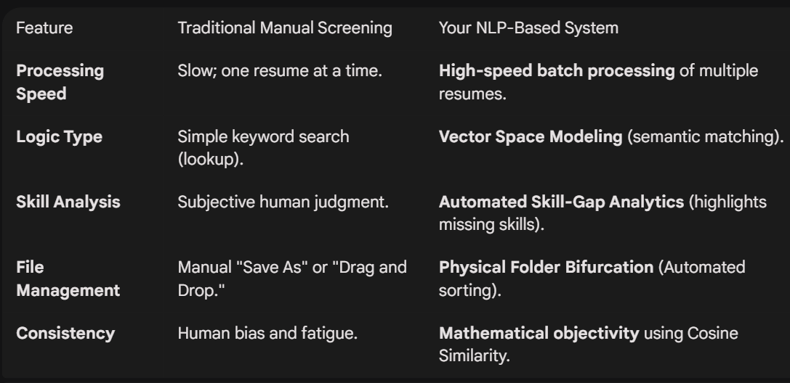
Traditional Screening vs. Our AI System

Slide 10

Code:
import os
import re
import shutil
from pdfminer.high_level import extract_text
from sklearn.feature_extraction.text import TfidfVectorizer
from sklearn.metrics.pairwise import cosine_similarity
def clean_text(text):
text = text.lower()
text = re.sub(r'[^a-z\s]', ' ', text)
text = re.sub(r'\s+', ' ', text).strip()
return text
def check_skill_gaps(resume_text, jd_text):
# This list defines the NLP features we are looking for
TECHNICAL_SKILLS = ["python", "sql", "machine learning", "nlp", "data science", "aws", "azure", "java", "tableau"]
resume_words = set(clean_text(resume_text).split())
jd_words = set(clean_text(jd_text).split())
found = [s for s in TECHNICAL_SKILLS if s in resume_words]
missing = [s for s in TECHNICAL_SKILLS if s in jd_words and s not in resume_words]
return found, missing
def run_nlp_screener():
input_folder = "nlp"
job_description = "Looking for a Data Scientist with Python, SQL, and Machine Learning skills. Experience in NLP is a plus."
threshold = 60
# Create destination folders for automated categorization
for folder in ["Shortlisted_Candidates", "Rejected_Candidates"]:
if not os.path.exists(folder):
os.makedirs(folder)
if not os.path.exists(input_folder):
print(f"❌ Error: Folder '{input_folder}' not found!")
return
resume_files = [f for f in os.listdir(input_folder) if f.endswith('.pdf')]
if not resume_files:
print(f"📂 No PDF resumes found in '{input_folder}'.")
return
print(f"🚀 Found {len(resume_files)} resumes. Starting NLP Analysis...\n")

Slide 11

print(f"🚀 Found {len(resume_files)} resumes. Starting NLP Analysis...\n")
for file_name in resume_files:
full_path = os.path.join(input_folder, file_name)
try:
# Step 1: Text Extraction
raw_resume = extract_text(full_path)
clean_resume = clean_text(raw_resume)
clean_jd = clean_text(job_description)
# Step 2: TF-IDF Vectorization
vectorizer = TfidfVectorizer(ngram_range=(1,2))
tfidf_matrix = vectorizer.fit_transform([clean_resume, clean_jd])
# Step 3: Cosine Similarity Math
raw_similarity = cosine_similarity(tfidf_matrix[0:1], tfidf_matrix[1:2])[0][0]
found, missing = check_skill_gaps(raw_resume, job_description)
# Step 4: Final Accuracy Calculation
boost = (len(found) / (len(found) + len(missing))) if (len(found) + len(missing)) > 0 else 0
accuracy = round((raw_similarity * 0.3 + boost * 0.7) * 100, 2)
# Step 5: Final Output & Action
print("="*60)
print(f"FILE: {file_name}")
print(f"MATCH ACCURACY: {accuracy}%")
print(f"✅ DETECTED SKILLS: {', '.join(found) if found else 'None Detected'}")
if accuracy >= threshold:
print("DECISION: 🟢 SHORTLISTED")
shutil.copy(full_path, os.path.join("Shortlisted_Candidates", file_name))
print(f"ACTION: Copied to 'Shortlisted_Candidates' folder.")
else:
print("DECISION: 🔴 REJECTED")
shutil.copy(full_path, os.path.join("Rejected_Candidates", file_name))
print(f"ACTION: Copied to 'Rejected_Candidates' folder.")
if missing:
print(f"💡 MISSING CORE SKILLS: {', '.join(missing).upper()}")
print("="*60 + "\n")
except Exception as e:
print(f"⚠️ Error processing {file_name}: {e}")
if __name__ == "__main__":
run_nlp_screener()

Slide 12
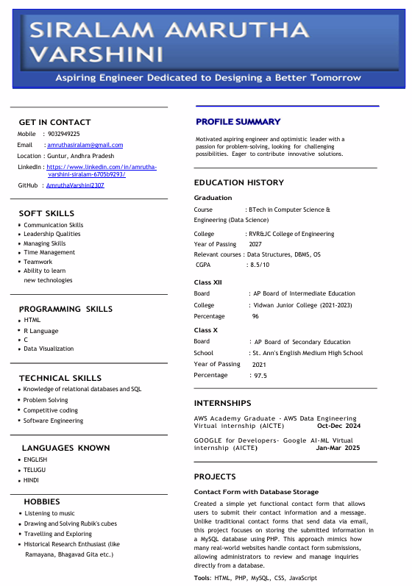

Slide 13
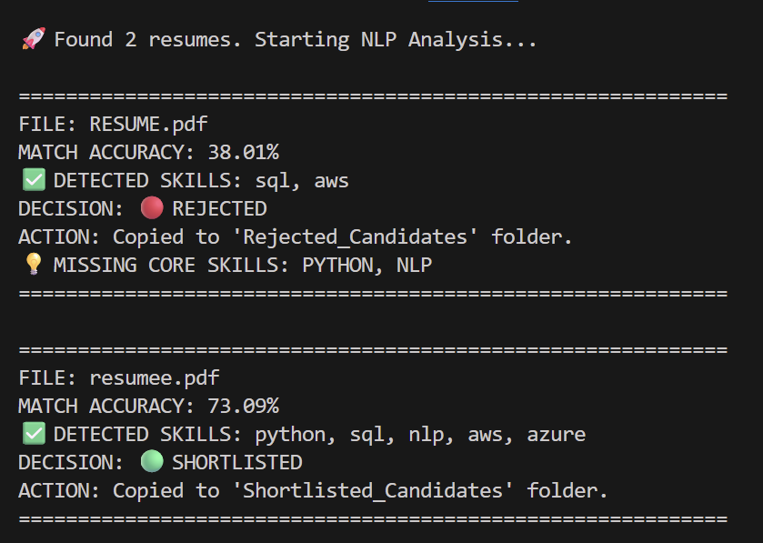
Output:

Slide 14

Conclusion:
.
Resume Screening using NLP automates the hiring process efficiently.
The system accurately matches resumes with job requirements.
Minimizes human bias in candidate selection.
It reduces manual effort, saves time, and improves recruitment quality
Efficiently handles large numbers of resumes.
Future Scope:
Real-time Portal Integration: The system can be expanded into a web-based platform using Flask or Django for real-time resume uploading and instant HR dashboard updates.
AI-based skill recommendation can be added.

